Slide 1

University Institute of Liberal Arts and Humanities
Course Name – Communication Skills
Course Code – 23PCH-105
Sentence Improvement
DISCOVER . LEARN . EMPOWER

Slide 2
COURSE OBJECTIVES
The Course aims to:
1 | Augment students overall communication and interpersonal skills by making them realize the importance of good oral and written English Language in professional life.
2 | Enrich their reading capability with special emphasis on expanding vocabulary and grammatical formations.
3 | Build exceptional speaking, reading and writing skills by correcting grammatical errors and pronunciation through practice.
4 | Enhances soft skills by fostering self awareness, confidence and a positive attitude in students’ ability to communicate effectively in English.

Slide 3
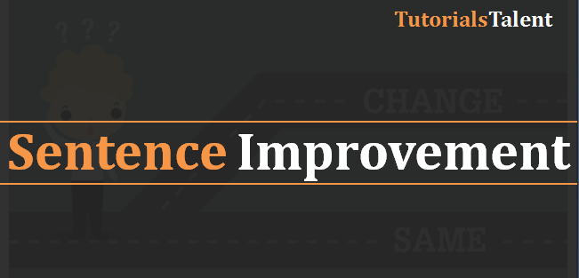
COURSE OUTCOMES
The students are expected to
CO Number | Title | Level
CO1 | Apply appropriate Listening, Speaking, Reading and Writing Skills (LSRW Skills) with correct non-verbal cues to attain expertise in soft skills. | Apply
CO2 | Apply correct contextual and comprehensible written text in the form of paragraph writing, short compositions business correspondence, using logical support and argument in a wide range of communication situations. | Apply
CO3 | Demonstrate linguistic competence while speaking and during presentations through accuracy in grammatical usage, vocabulary, pronunciation and intonation. | Apply
CO4 | Evaluate information as critical readers, speakers and writers applying ethics in communication and being sensitive in cross cultural communication. | Evaluate
CO5 | Create original, digital content for websites, blogs, vlogs and personal social media profiles etc. | Create
...
asmartstudyzone.blogspot.com

Slide 4
What are Sentences?
The sentence is generally defined as a word or a group of words that expresses a thorough idea by giving a statement/order, or asking a question, or exclaiming.
A sentence is the largest unit of any language. In English, it begins with a capital letter and ends with a full-stop, or a question mark, or an exclamation mark.
For e.g. :- He is a good boy (statement) Is he a good boy? (question), What a nice weather! (exclaiming).
Shutterstock.com

Slide 5
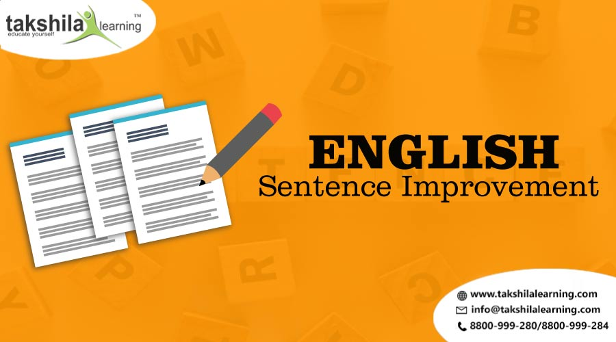
Sentence Improvement
Sentence improvement is a type of grammatical practice where a sentence is given with a word or a phrase that requires grammatical changes or improvement.
A sentence requires modification grammatically and contextually to have a better understanding of the same.

Slide 6
Strategies
Before you look at the choices, read the sentence and think of a word that makes sense.
Look at all the possible answers before you make your final choice
In double-blank sentences, go through the answers, testing the first word in each choice
Use your knowledge of etymology and parts of speech to get at the meanings of unfamiliar words
Identify trigger words, understand their function
Break down complex sentences into simpler components
Develop intuitive sense by reading extensively on as many new areas as you can explore.

Slide 7
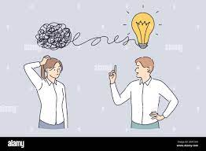
Improvement Based on Subject – Verb Agreement
A singular subject will take a singular verb.
Verb ending with ‘-s’ is singular.
The phrase “one of the” will always take a plural subject and a singular auxiliary verb after the subject.
Sentence using ‘each’ or ‘every’ will take a singular subject. E.g. Every child in the village was vaccinated.
Pinterest.com

Slide 8
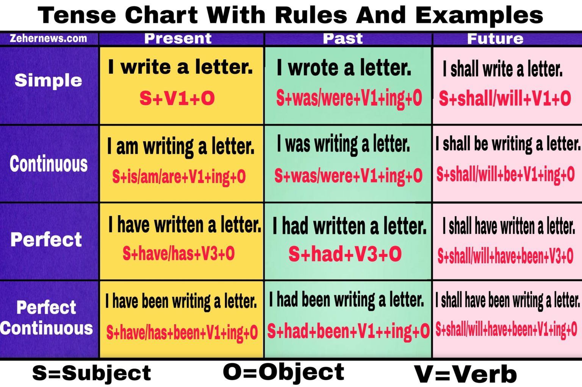
Improvement Based on tenses

Slide 9
Improvement Based on Preposition
At’ is Used to Describe a Specific Time or Location. E.g., I met him at the station.
‘On’ is used for days or dates. E.g., Americans celebrate Independence Day on the 4th of July. The last holiday was on Monday.
‘For’ is used to describe a duration of time. E.g., The show went on for four hours.
‘Since’ is used to describe a specific point in time. E.g. It has been raining since yesterday. The lecture has been going on since 4 p.m
‘In’ is used to describe a specific time of the day, week, month or year. E.g. I play tennis in the morning. The crop is harvested in summer.
‘In’ is also used to describe a specific location that is in the interior of something. It is also used to describe a large area. E.g., The cat was in the box. I was in Canada.

Slide 10
Improvement Based on Pronouns
Nominative pronouns are used to denote the subject of a sentence. E.g. I, he, she etc.
Object pronouns are used to denote the object of a sentence. E.g. Me, him, her etc.
Possessive pronouns denote possession or ownership of something. E.g. His, hers, yours etc.

Slide 11
Improvement Based on Pronouns
Reflexive pronouns are used when the subject and object of a sentence are the same. E.g., Himself, herself, yourself, etc.
‘Who’ is a pronoun used to refer to the subject of a sentence. E.g. Who is singing? ‘Whom’ is used to refer to the object of a sentence. E.g. To whom should I refer to in the letter? If the answer is ‘he’, use ‘who’. ., If the answer is ‘him’, use ‘whom’.

Slide 12
Improvement Based on Parallelism and Vocabulary
Words of the same quality or indicating similar functions should be in a similar format. E.g. He is texting and driving. (correct) He is texting and drive. (incorrect)
Words similar in pronunciation may have different meanings. For example, affect is a verb which means impact. Effect is a noun which indicates the result of a change. Later means at a time in the future, latter means second of the two things mentioned.
Some words are more appropriate in certain situations. For example: ‘The jury reached a verdict’ is more appropriate than ‘the jury reached a decision’.

Slide 13
Tips to Improve a sentence
Cause and Effect The sentences framed with the words like ‘so’, ‘since’, ‘as a result of ‘, ‘because’, ‘therefore’ hints the cause and effect. Ex; the child ate an Ice-cream, so, he ____. a) Caught cold b) Was thrilled c) Decided to eat one more d) Wanted to buy Ice cream shop.

Slide 14
Tips to Improve a sentence
Punctuations marks like Colon, Semicolon, Coma, means something more, gives more information. Ex; “The politician was acting according to the interests”, of his _____ in his own town. a) Participants b) Passers by c) Supporters d) Commitments

Slide 15
Tips to Improve a sentence
c) Parts of Speech When one is good at identifying the parts of speech in the structure of the sentence, can easily pick the right answer. Ex; Shakespeare has gained extra ordinary ______ throughout the world. a) Aggressively b) Abdicating c) Momentous d) Recognition

Slide 16
Applications
Applicable to personal and professional life.
Will strengthen the grammar skills of students.
Will strengthen students’ communication skills.
Students will be able to write better both at college and at workplace in future.

Slide 17
Assessment Pattern
Students are assessed on the basis of the following parameters:
Hourly Test- 2
Assignments
Surprise Test
Quiz
Engagement Task
End Semester Exam

Slide 18
References
Book Lesikar R.V., Petit J.D., Business Communication, Tata McGraw (2016), New Delhi.
https://www.embibe.com/exams/chapter/sentence-improvement/
https://www.gazabnews.com/tense-chart/

